Slide 1
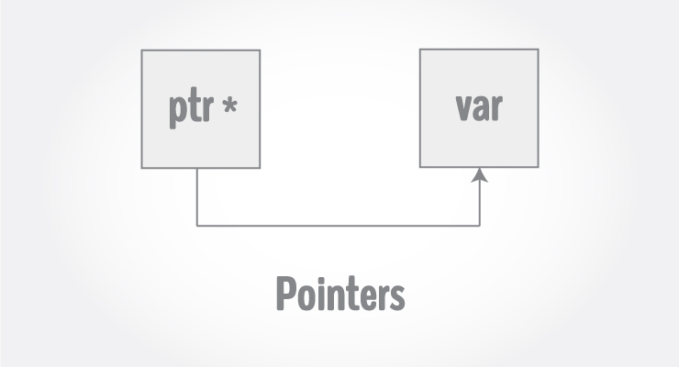
C Pointers

Slide 2
Every variable is a memory location and every memory location has its address defined which can be accessed using ampersand (&) operator, which denotes an address in memory
#include <stdio.h>
int main()
{
int var = 5;
printf("Value: %d\n", var);
printf("Address: %u", &var);
return 0;
}
Value: 5
Address: 2686778

Slide 3
What are Pointers?
A pointer is a variable whose value is the address of another variable, i.e., direct address of the memory location.
Syntax to declare a pointer variable
type *var-name;
Examples
int *ip; /* pointer to an integer */
double *dp; /* pointer to a double */
float *fp; /* pointer to a float */
char *ch /* pointer to a character */

Slide 4
How to Use Pointers?
(a) We define a pointer variable
(b) assign the address of a variable to a pointer
(c) finally access the value at the address available in the pointer variable. This is done by using unary operator * (dereferencing operator) that returns the value of the variable located at the address specified by its operand.

Slide 5
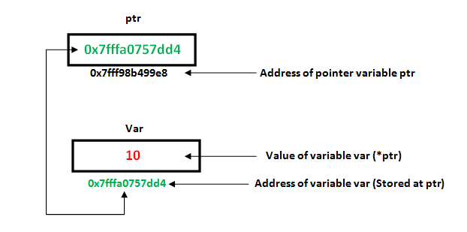

Slide 6
Assignment of Pointer Variables (Cont ..)
float data = 50.8;
float *ptr;
ptr = &data;
FFF0
FFF1
FFF2
FFF3
data
FFF4
50.8
FFF5
FFF6

Slide 7
Assignment of Pointer Variables
float data = 50.8;
float *ptr;
ptr = &data;
ptr
FFF0
FFF1
FFF2
FFF3
data
FFF4
50.8
FFF5
FFF6

Slide 8
Assignment of Pointer Variables
float data = 50.8;
float *ptr;
ptr = &data;
ptr
FFF0
FFF4
FFF1
FFF2
FFF3
data
FFF4
50.8
FFF5
FFF6

Slide 9
Using pointers to access address and value of a Variable
#include <stdio.h>
int main () {
int var = 20; /* actual variable declaration */
int *ip; /* pointer variable declaration */
ip = &var; /* store address of var in pointer variable*/
printf("Address of var variable: %x\n", &var );
/* address stored in pointer variable */
printf("Address stored in ip variable: %x\n", ip );
/* access the value using the pointer */
printf("Value of *ip variable: %d\n", *ip );
return 0;
}
Address of var variable : bffd8b3c
Address stored in ip variable : bffd8b3c
Value of *ip variable : 20

Slide 10
Changing the value of a variable through pointers
#include <stdio.h>
int main(){
int* pc;
int c;
c=22;
printf("Address of c:%u\n",&c);
printf("Value of c:%d\n\n",c);
pc=&c;
printf("Address of pointer pc:%u\n",pc);
printf("Content of pointer pc:%d\n\n",*pc);
c=11;
printf("Address of pointer pc:%u\n",pc);
printf("Content of pointer pc:%d\n\n",*pc);
*pc=2;
printf("Address of c:%u\n",&c);
printf("Value of c:%d\n\n",c);
return 0;
}
Address of c: 2686784
Value of c: 22
Address of pointer pc: 2686784
Content of pointer pc: 22
Address of pointer pc: 2686784
Content of pointer pc: 11
Address of c: 2686784
Value of c: 2

Slide 11
Pointer Analysis – Say Correct or Wrong
int c, *pc;
pc = c;
// Wrong! pc is address whereas, c is not an address.
*pc = &c;
// Wrong! *pc is the value pointed by address whereas, %amp;c is an address.
pc = &c;
// Correct! pc is an address and, %amp;pc is also an address.
*pc = c;
// Correct! *pc is the value pointed by address and, c is also a value.

Slide 12
Operations on Pointer Variables
Assignment – the value of one pointer variable can be assigned to another pointer variable of the same type
Relational operations - two pointer variables of the same type can be compared for equality, and so on
Some limited arithmetic operations
integer values can be added to and subtracted from a pointer variable
value of one pointer variable can be subtracted from another pointer variable

Slide 13
Pointer Expressions and Pointer Arithmetic
#include <stdio.h>
int main()
{
int num1=2, num2=3,sum=0,mul=0,div=1;
int *ptr1, *ptr2;
ptr1=&num1;
ptr2=&num2;
sum=*ptr1 + *ptr2;
mul=sum * *ptr1;
*ptr2 +=1;
div=9 + *ptr1 / *ptr2 - 30;
printf("%d, %d, %d", sum, mul, div);
return 0;
}

Slide 14
Pointer arithmetic – Incrementing/Decrementing a pointer
#include <stdio.h>
const int MAX = 3;
int main ()
{
int var[] = {10, 100, 200};
int i, *ptr;
/* let us have array address in pointer */
ptr = var;
for ( i = 0; i < MAX; i++) {
printf("Address of var[%d] = %x\n", i, ptr );
printf("Value of var[%d] = %d\n", i, *ptr );
ptr++;
}
return 0;
}
Address of var[0] = bf882b30
Value of var[0] = 10
Address of var[1] = bf882b34
Value of var[1] = 100
Address of var[2] = bf882b38
Value of var[2] = 200

Slide 15
*ptr++

Slide 16
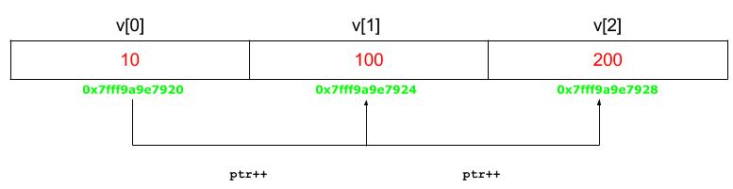

Slide 17
Pointer arithmetic –Pointer Comparisons
#include <stdio.h>
const int MAX = 3;
int main () {
int var[] = {10, 100, 200};
int i, *ptr;
/* let us have address of the first element in pointer */
ptr = var;
i = 0;
while ( ptr <= &var[MAX - 1] ) {
printf("Address of var[%d] = %x\n", i, ptr );
printf("Value of var[%d] = %d\n", i, *ptr );
ptr++;
i++;
}
return 0;
}
Address of var[0] = bfdbcb20
Value of var[0] = 10
Address of var[1] = bfdbcb24
Value of var[1] = 100
Address of var[2] = bfdbcb28
Value of var[2] = 200

Slide 18
NULL Pointers
It is always a good practice to assign a NULL value to a pointer variable in case you do not have an exact address to be assigned.
#include <stdio.h>
int main () {
int *ptr = NULL;
printf("The value of ptr is : %x\n", ptr );
return 0;
}
To check for a null pointer, you can use an 'if' statement as follows −
if(ptr) /* succeeds if p is not null */
if(!ptr) /* succeeds if p is null */

Slide 19
void Pointer/ generic pointer
Void pointer can store the address of variable belonging to any of the data type. So, void pointer is also called as general purpose pointer.
malloc() and calloc() return void * type
It has some limitations −
1) Pointer arithmetic is not possible with void pointer due to its concrete size.
2) It can’t be used as dereferenced.
#include<stdlib.h>
int main() {
int a = 10;
float b = 10.5;
void *p;
p = &a;
printf("Integer variable is = %d", *( (int*) p) );
p = &b;
printf("\nFloat variable is = %f", *( (float*) p) );
return 0; }

Slide 20
const pointer
Const pointer is a pointer that can’t change the address of the variable that is pointing to.
const char *ptr : This is a pointer to a constant character. You cannot change the value pointed by ptr, but you can change the pointer itself.
There is no difference between const char *p and char const *p as both are pointer to a const char and position of ‘*'(asterik) is also same.
char *const ptr : This is a constant pointer to non-constant character. You cannot change the pointer p, but can change the value pointed by ptr.
const char * const ptr : This is a constant pointer to constant character. You can neither change the value pointed by ptr nor the pointer ptr.

Slide 21
const pointer
#include<stdio.h>
#include<stdlib.h>
int main()
{
char a ='A', b ='B';
const char *ptr = &a;
//*ptr = b; illegal statement (assignment of read-only location *ptr)
// ptr can be changed
printf( "value pointed to by ptr: %c\n", *ptr);
ptr = &b;
printf( "value pointed to by ptr: %c\n", *ptr);
}

